Slide 1
Creating an Application UI
Section 2
Notes:
Basic Application UI
Interaction of UI with Models
ViewModel & LiveData
Inversion of Control and Dependency Injection
Implement MVP (Move logic to Presenter)
Repeat the process for list item detail Screen

Slide 2
Creating a visual list of projects

Slide 3
View
Simple architecture
Controller
Model

Slide 4
ListView
StringAdapter
In this video we will use

Slide 5
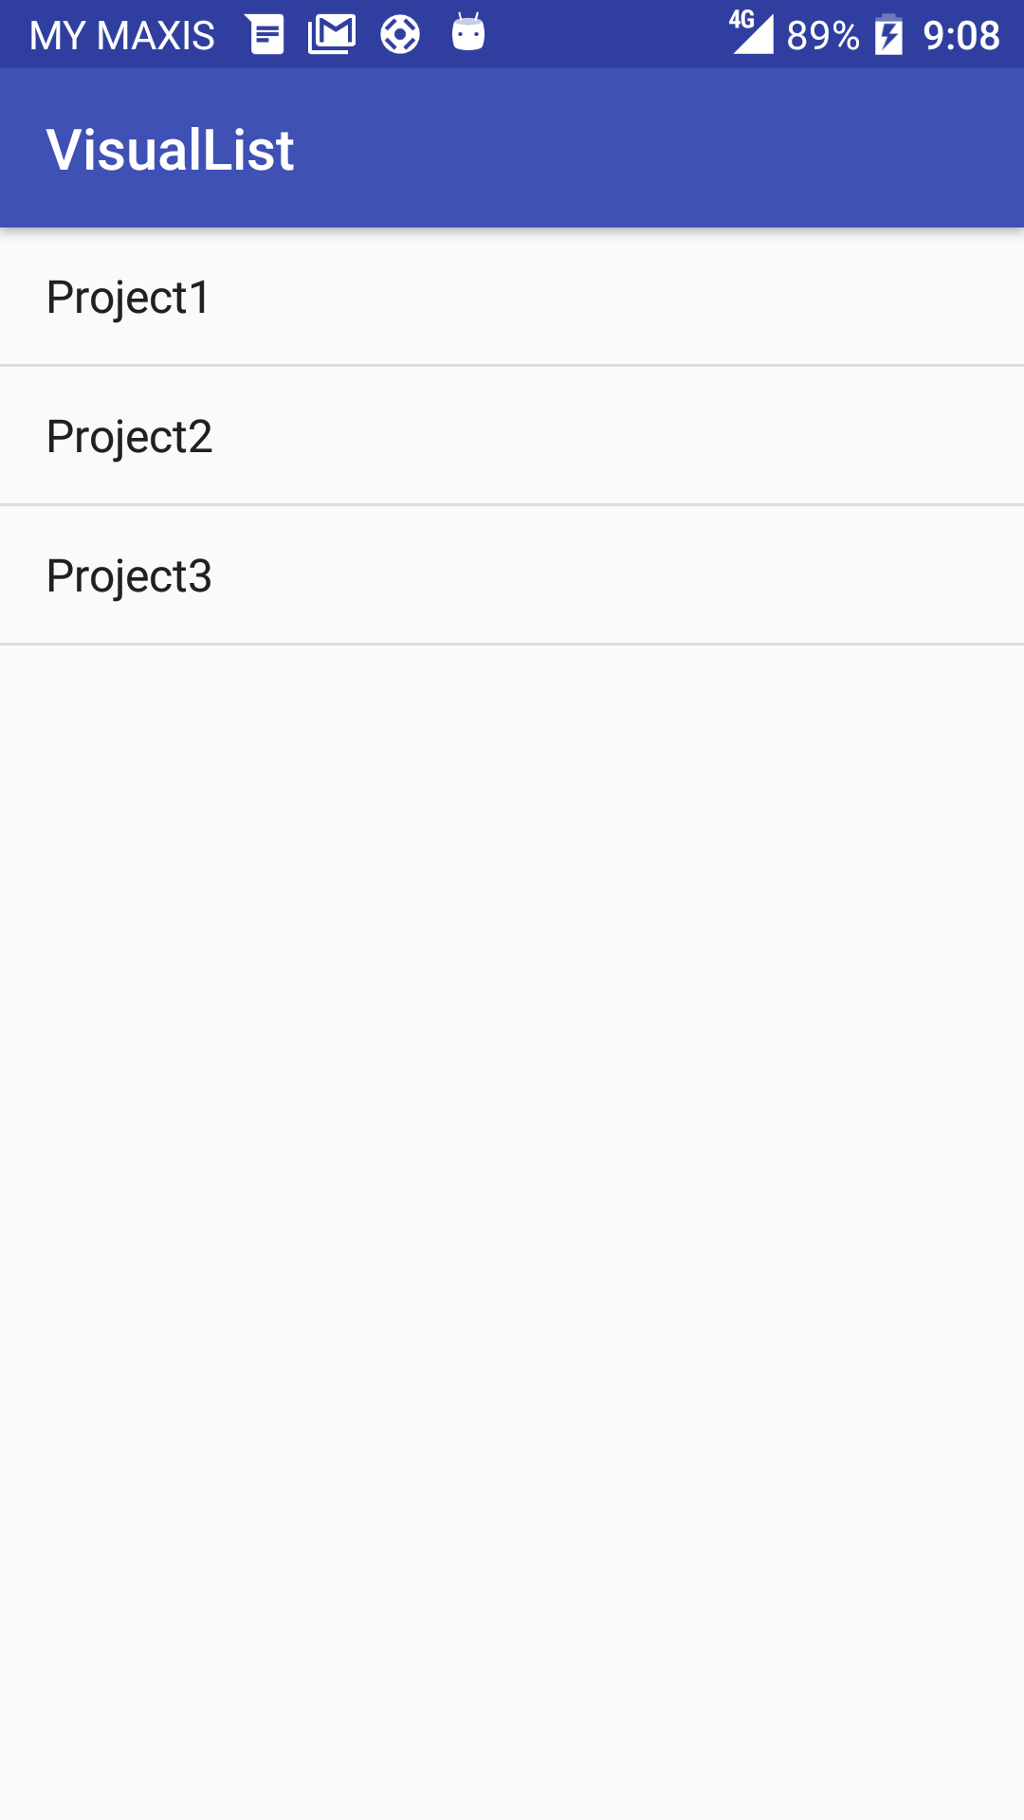
Result

Slide 6
Extracting a model from our UI needs
Next Video

